Slide 1
Team Members
Shrikanth Ankit Raj
Capstone Project
Company Classification

Slide 2
Content
Problem statement
Data summary
Covering insights
Challenges
Conclusions

Slide 3
Problem Statement
We are given with web scraped data of various businesses and companies.
We need to somehow categorize these businesses and companies across a standard taxonomy (consists of term names and labels that are specific to an organization's information and unique to how that business operates). So that, business can leverage this information and target potential companies.

Slide 4
Data Summary
We have records of 73974 companies with 9 columns/features.
Each feature is a text data.
We will be left with only 4K records, if we remove all the null values at the first place.

Slide 5
Data Overview
Website: The website of the company/business
Company Name: The company/business name
Homepage Text : Visible homepage text
H1: The heading 1 tags from the html of the home page
H2: The heading 2 tags from the html of the home page
H3: The heading 3 tags from the html of the home page
Navlink text: The visible titles of navigation links on the homepage (Ex: Home, Services, Product, About Us, Contact Us)
Meta keywords: The meta keywords in the header of the page html for SEO
Meta description: The meta description in the header of the page html for SEO

Slide 6
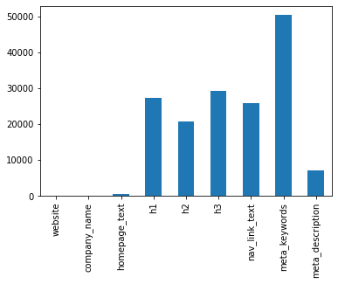
Techniques Implemented
In the given data there were more null values equally spread across all the major columns. To avoid data loss we have combined all the columns as we are dealing with text.
We also analysed individual columns to gain insights.

Slide 7
Data Preprocessing
Handled null values
Removed punctuations
Removed digits
Removed stop words
Removed special characters
Stemming/Lemmatization
Removed short words

Slide 8
Word Embedding
Word embedding is a term used for the representation of words for text analysis
Few popular techniques are:
Countvectorizer
TF-IDF Vectorizer
Word2Vec
We experimented with different techniques
and out of which TF-IDF gave us better results.
Notes:
typically in the form of a real-valued vector that encodes the meaning of the word such that the words that are closer in the vector space are expected to be similar in meaning

Slide 9
Using K Means
Kmeans is an unsupervised machine learning algorithm used for classification.
To solve this problem statement, we went ahead with K Means algorithm to categorize the companies into multiple clusters.

Slide 10
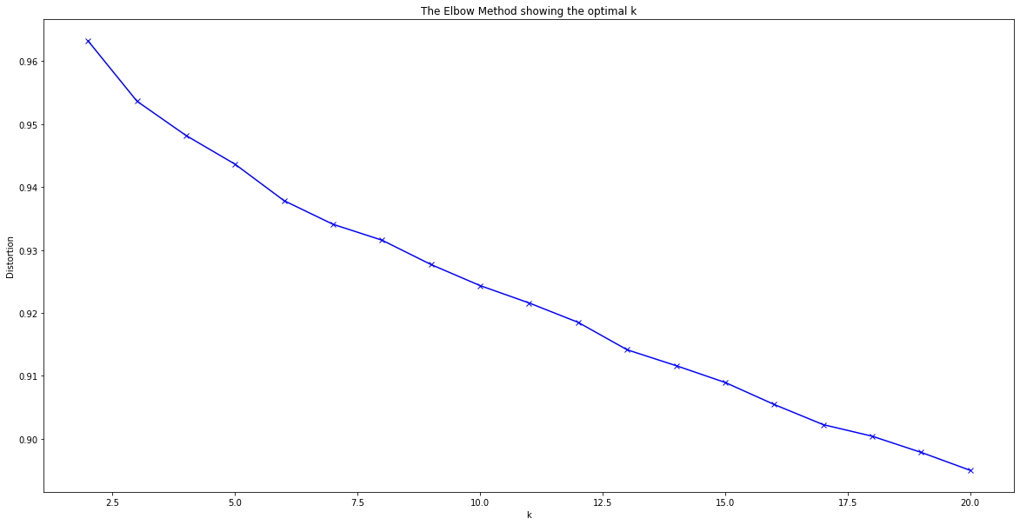
Optimal number of clusters..
By using Elbow method and Silhouette score, we came up with 12 as an optimal of clusters.
Elbow method

Slide 11
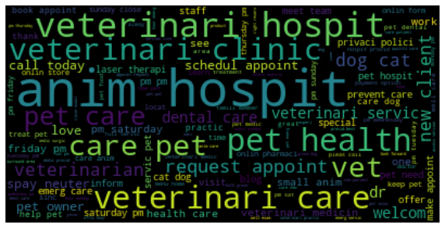
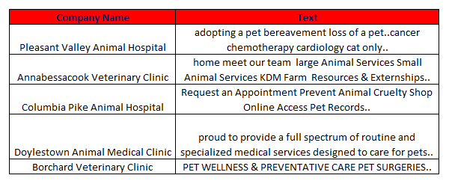
Cluster 1 :
PET HEALTHCARE
Example sentences

Slide 12
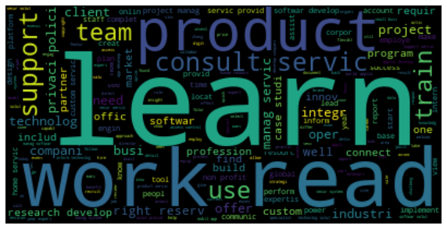
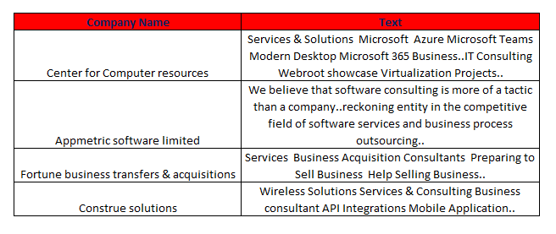
Cluster 2 :
IT SERVICES
Example sentences

Slide 13
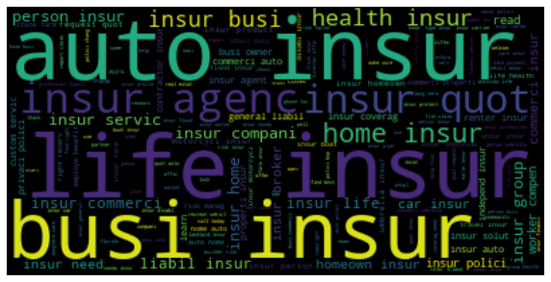
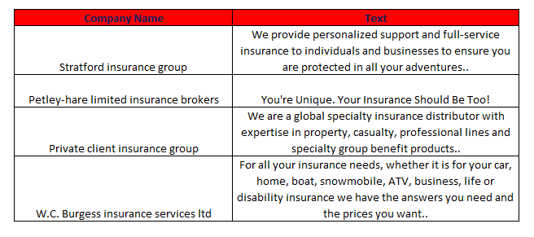
Cluster 3 :
INSURANCE
Example sentences

Slide 14
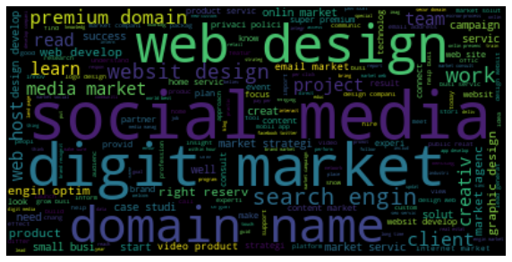
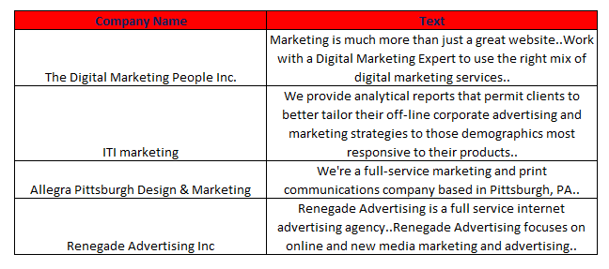
Cluster 4 :
DIGITAL MARKETING
Example sentences

Slide 15
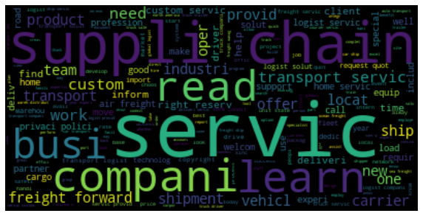
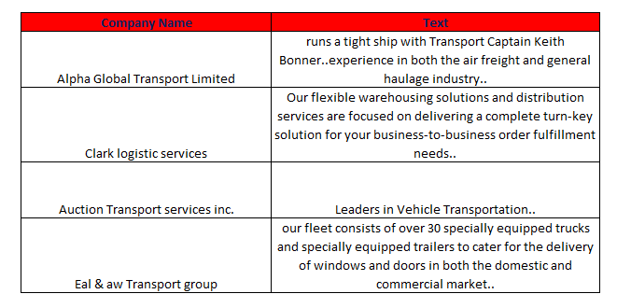
Cluster 5 :
LOGISTICS
Example sentences

Slide 16
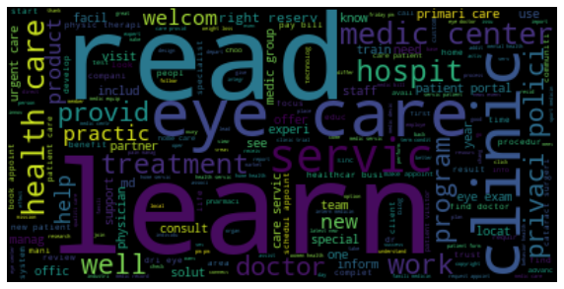
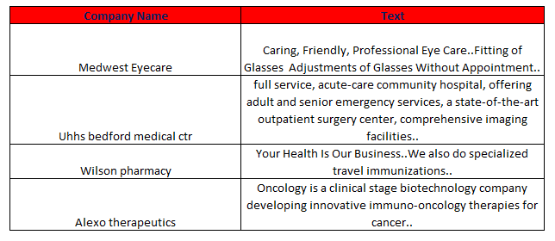
Cluster 6 :
HEALTHCARE (EYE CARE)
Example sentences

Slide 17
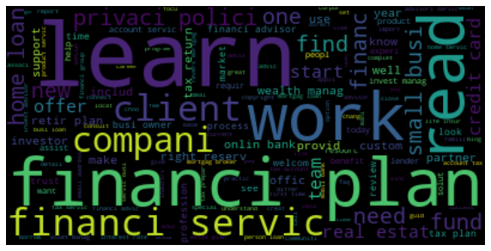
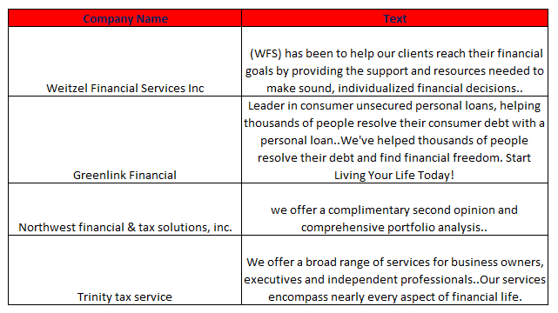
Cluster 7 :
FINANCIALS
Example sentences

Slide 18
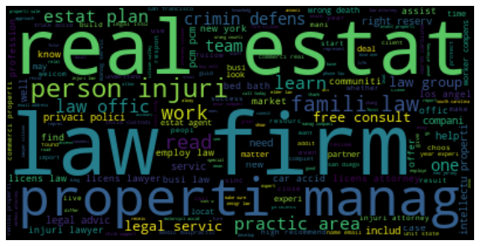
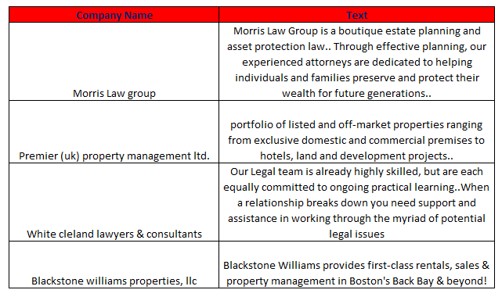
Cluster 8 :
REAL ESTATE & LEGAL AFFAIRS
Example sentences

Slide 19
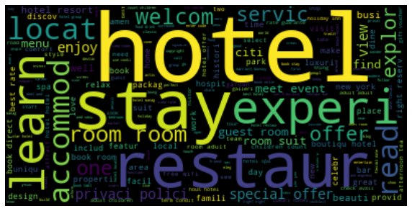
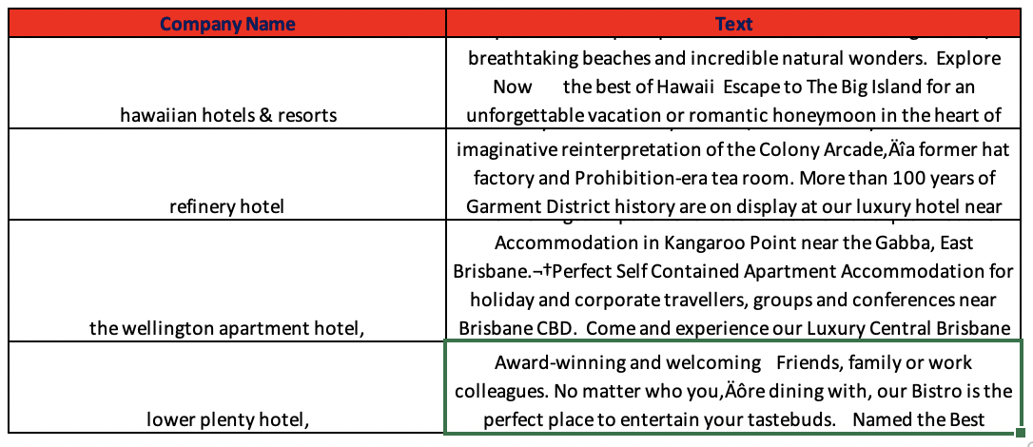
Cluster 9 :
HOSPITALITY
Example sentences

Slide 20
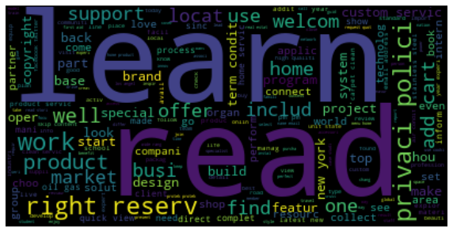
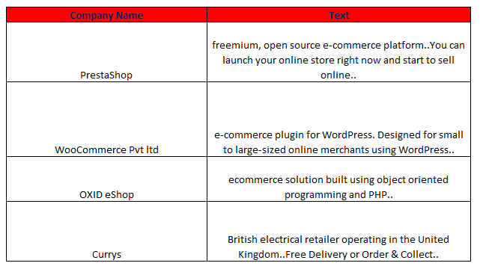
Cluster 10 :
E-COMMERCE
Example sentences

Slide 21

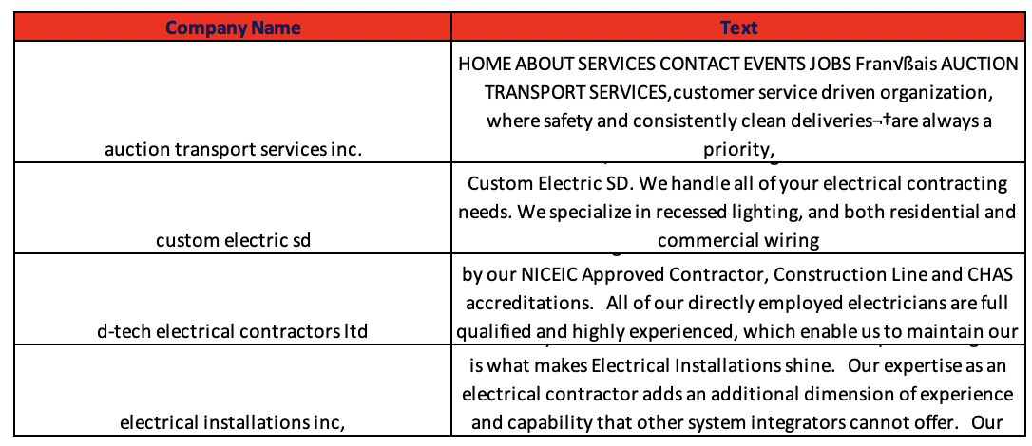
Cluster 11 :
HOME SERVICES
Example sentences

Slide 22
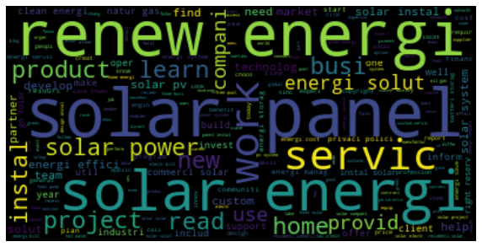
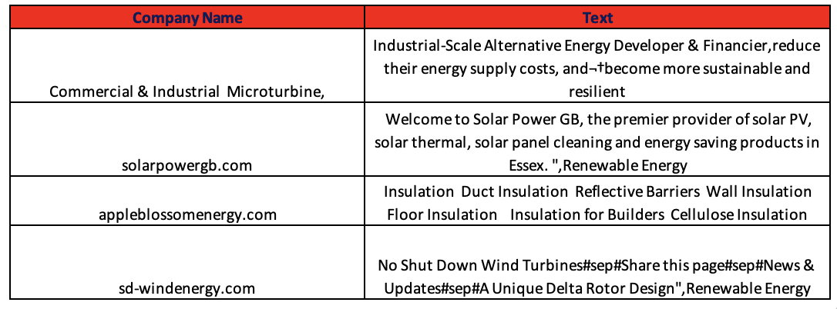
Cluster 12 :
RENEWABLE ENERGY & UTILITIES
Example sentences

Slide 23
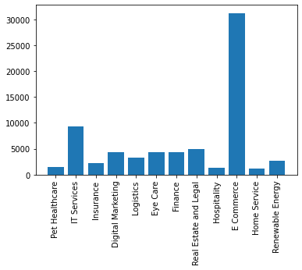
Distribution of Categories
COUNT
CATEGORIES

Slide 24
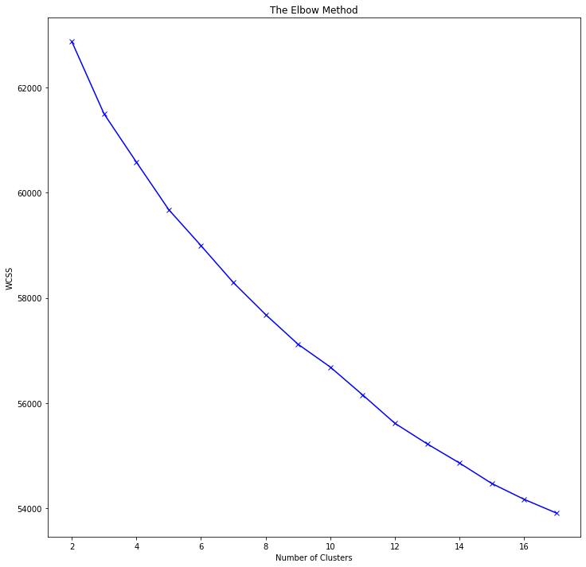
Optimal Clusters
By using Elbow method and Silhouette score, we came up with 9 as an optimal number of clusters.

Slide 25
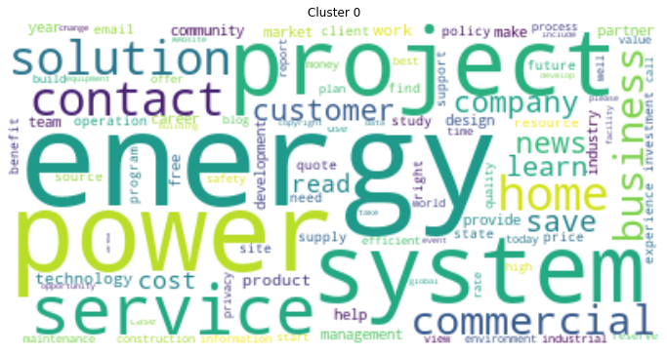
Cluster 1 : ENERGY & UTILITIES

Slide 26
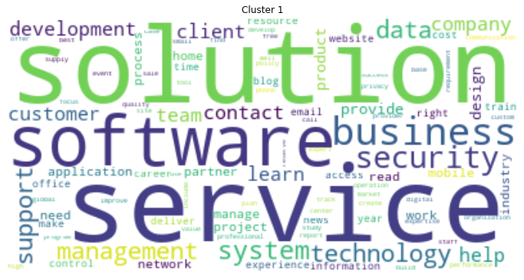
Cluster 2 : INFORMATION TECHNOLOGY

Slide 27
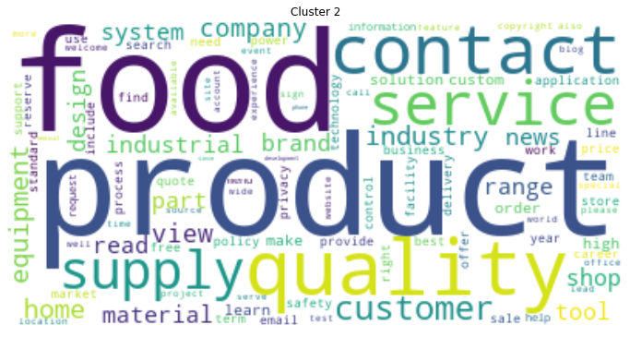
Cluster 3 : FOOD DELIVERY SERVICES

Slide 28
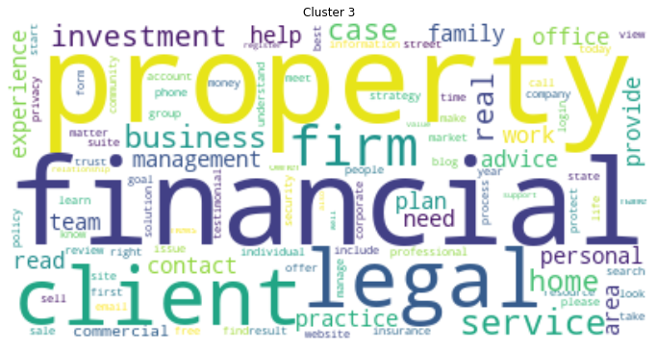
Cluster 4 : REAL ESTATE & LEGAL

Slide 29
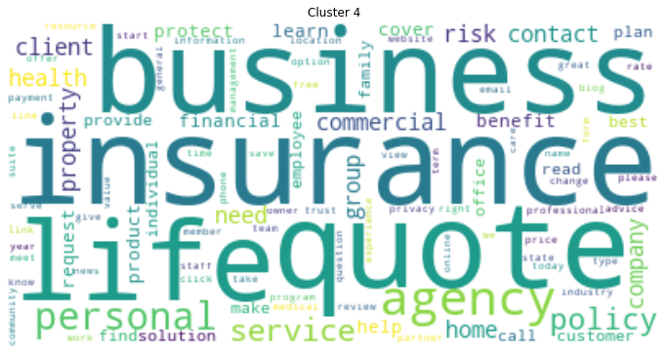
Cluster 5 : INSURANCE

Slide 30
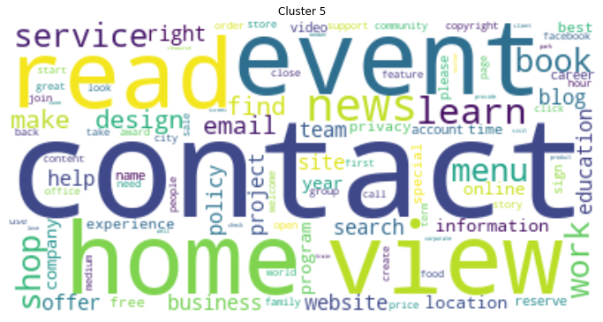
Cluster 6 : EVENT MANAGEMENT

Slide 31
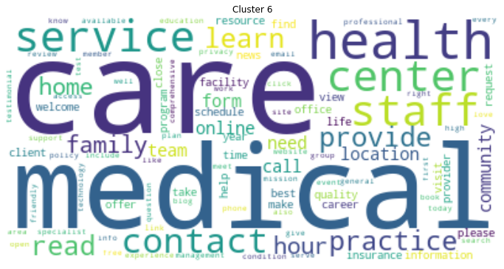
Cluster 7 : HEALTHCARE

Slide 32
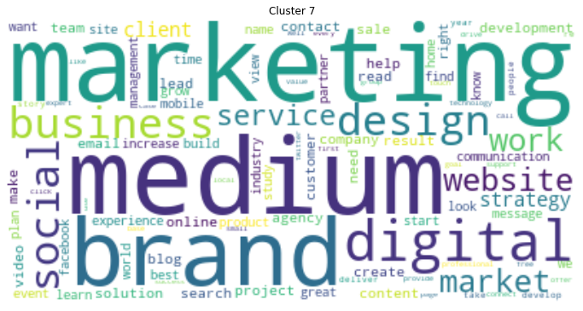
Cluster 8 : DIGITAL MARKETING

Slide 33
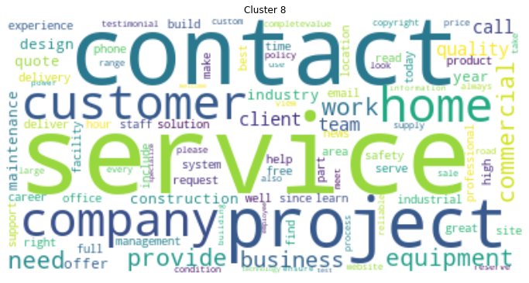
Cluster 9 : HOME SERVICES

Slide 34
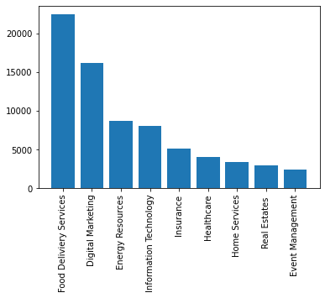
Distribution based on ‘Homepage_txt’ Column
COUNT
CATEGORIES

Slide 35
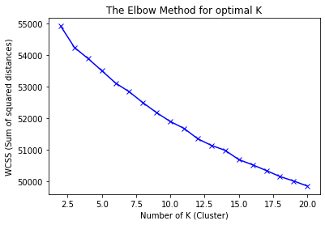
Optimal Clusters
By using Elbow method and Silhouette score, we came up with 12 as an optimal number of clusters.
Real Estate
Legal Affairs
Food Services
IT services
Logistics
Insurances
Healthcare
Industrials
Eatery Industry
Digital Marketing
Hospitality
Energy & Utilities

Slide 36
INSIGHTS FROM
Meta_keywords & Meta_description..

Slide 37
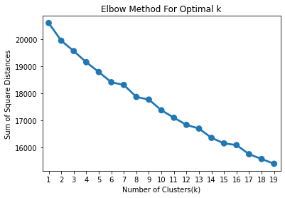
Optimal Clusters
By using Elbow method and Silhouette score, we came up with 9 as an optimal number of clusters
Real Estate & Legal Affairs
Food services
Digital Marketing
Financials
Energy & Utilities
Insurances
Home Services
Industrials
Healthcare

Slide 38
Challenges
Text Preprocessing as there were characters from multiple scripts.
There were lot of null values that we had to handle carefully.
Limited resources : Dataset turned to be large for computation power we have.
Deciding the number of optimal clusters was bit difficult since the dataset is really vast and can have more number of clusters.

Slide 39
Conclusion
As we observed “E-commerce” was the top cluster from overall perspective, we can further dig down and do sub-clustering to gain more insights.
We were able to categorize businesses/companies in 9 to 12 clusters based on different features and on the combination of whole features as well.
Those clusters represent various industries and we can approach those companies of each cluster with relevant business proposals.

Slide 40
Q & A

